Slide 1




Semester Project
CPU Scheduling Algorithm Simulator

Slide 2



Group Members :
Awais Asif
UW-23-CY-BS-010
Rubaiqa Pervez
UW-23-CY-BS-020
Seemab Khan
UW-23-CY-BS-005

Slide 3
Introduction
CPU scheduling is a fundamental function of an Operating System.
It determines how CPU time is allocated among multiple processes.
Different scheduling algorithms directly affect:
Waiting Time
Turnaround Time
System fairness and efficiency
Understanding scheduling concepts through theory alone is difficult.
This project provides a GUI-based simulator to visualize and compare CPU scheduling algorithms.

Slide 4
Problem Statement
Students often struggle to understand:
Process execution order
Waiting time and turnaround time calculations
Differences between scheduling algorithms
Manual calculations are time-consuming.
Lack of interactive tools for learning CPU scheduling.
There is a need for a simple, interactive, and visual simulator for CPU scheduling algorithms.

Slide 5

Objectives of Project
Design a GUI-based CPU Scheduling Simulator.
Implement major CPU scheduling algorithms:
FCFS
SJF
Round Robin
Allow users to dynamically enter process data.

Slide 6
Conti ...
Calculate:
Waiting Time (WT)
Turnaround Time (TAT)
Average WT and Average TAT
Display execution order using a Gantt Chart.
Help students easily compare scheduling algorithms.

Slide 7

Project Scope
Development of a user-friendly GUI using Python.
Simulation of CPU scheduling algorithms.
Input of:
Process ID
Arrival Time
Burst Time
Time Quantum (for Round Robin)
Visualization of CPU execution using Gantt Charts.

Slide 8
CPU Scheduling Algorithms Implemented
First Come First Serve (FCFS)
Processes execute in arrival order.
Simple to implement.
May cause long waiting times
Round Robin (RR)
Each process gets fixed time quantum.
Ensures fairness.
Suitable for time-sharing systems.
Shortest Job First (SJF)
Process with smallest burst time executes first.
Reduces average waiting time.
Non-preemptive version implemented.

Slide 9
System Design Overview
The system follows a modular design approach:
Input Module
Takes process count and process details.
Algorithm Module
Implements FCFS, SJF, and Round Robin logic.
Calculation Module
Computes WT, TAT, and averages.
Output Module
Displays results and Gantt chart in GUI.

Slide 10
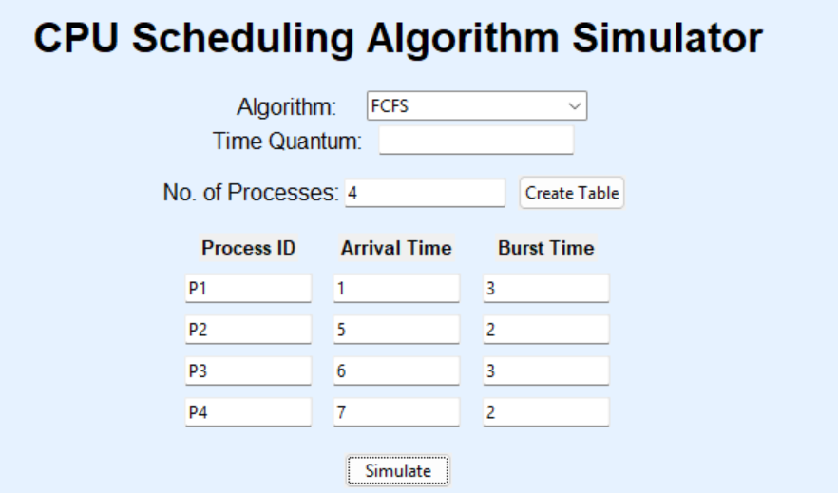

Slide 11
Tools and Technologies Used
Programming Language: Python
GUI Library: Tkinter
IDE: VS Code
Concepts Used:
CPU Scheduling
Process Management
Gantt Chart Visualization

Slide 12
Output Features
Tabular display of:
Arrival Time
Burst Time
Waiting Time
Completion Time
Turnaround Time
Automatic calculation of:
Average Waiting Time
Average Turnaround Time
Text-based Gantt Chart for visualization.
Clean and user-friendly interface.

Slide 13
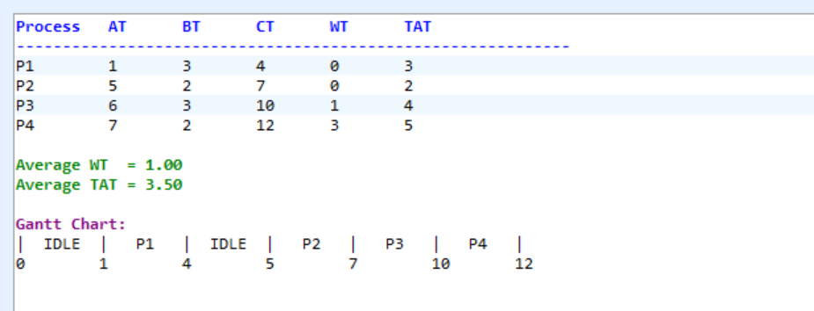
OUTPUT:

Slide 14



